Slide 1

eVTOL Air Vehicles – The Killer App for Hydrogen?
NC A&T ACIT-TECHLAV Seminar Series
NASA ULI S2A2 Project
October 2, 2020
Dr. Bruce J. Holmes D.E., FAIAA, FRAeS, Comm, Instr, AMEL, ASEL, ASES, CFI, AIGI, C525, FAA Master Pilot
Chief Technology Officer Skai (an Alakai Technologies Company)
Notes:
Electrification of power train systems for aviation is progressing more rapidly than many may be aware, even in the engineering community. These systems include mostly battery-electric (lithium ion, lithium sulfur) vehicle projects, and an emerging group of hydrogen fuel cell stack systems for electric VTOL and CTOL air vehicles. The public forecasts for growth of the use of these vehicles in commercial on-demand (air taxi) markets is for more than $800 Billion over the next ten years.
Oil has literally and figuratively fueled the 20th century – cars, wars, economies, and geopolitics. We are amid an energy shock that is accelerating a shift to a new order.
Leading indicators: ExxonMobil ejected from the Dow Jones Industrial Average (member since 1928). Saudi Arabia balances government budgets with oil at $70 - $80 /barrel; today is $40 / barrel
Today, fossil fuels provide 85% of global energy, with costs in loss of more than 4 Million deaths annually and political instabilities, through geographic concentrations of oil reserves leading to geopolitical shocks.
The emerging energy system includes solar and wind rising from 5% toward nearly 50% on 2050. This transition decentralizes and diversifies energy, geographically and technologically. Petrostates that have depended on sovereign funds will have to turn to taxing their own citizens and likely becoming more representative in governance.
The ”new energy order” requires three times today’s $250 Bn annual investments in wind and solar for example, plus in the case of Hydrogen, significant investments in infrastructure for electrolysis production of green H2, storage infrastructure, transport systems, and distributed fueling systems. These investments can create future in the 21st century could be better than the oil age for human health, political stability, and economic volatility.

Slide 2
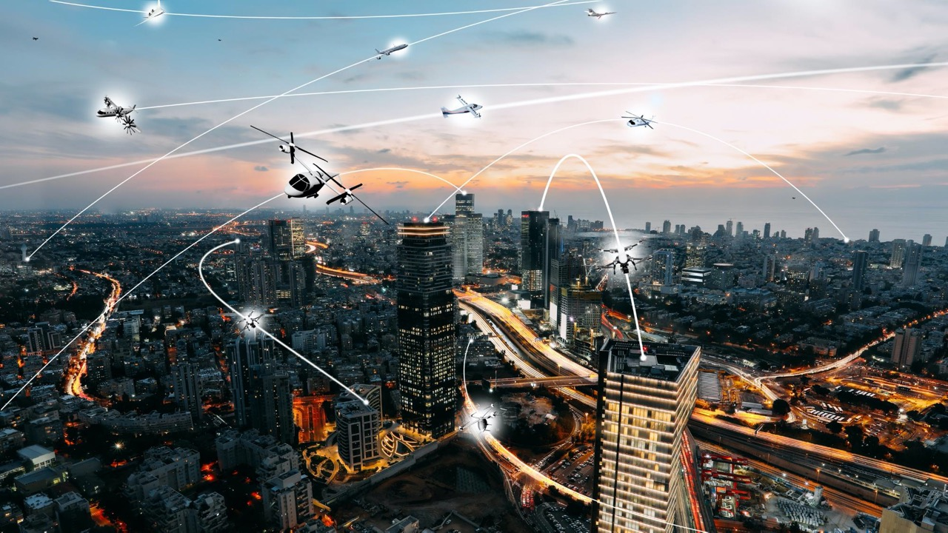


Fly-By-Wire & Light
Autonomous-capable
Long-endurance testing profiles
Cyber-secure data communications
Simulation & Full-scale flight test
S2A2 TC-4 Role: System Integration and Experimentation
Advanced Air Mobility (AAM)
Notes:
The FAA and NASA ConOps for AAM describes the envisioned operational environment that supports the expected growth of an air transportation system that moves people and cargo between local, regional, intraregional, and urban places previously not served or underserved by aviation using revolutionary new aircraft.

Slide 3
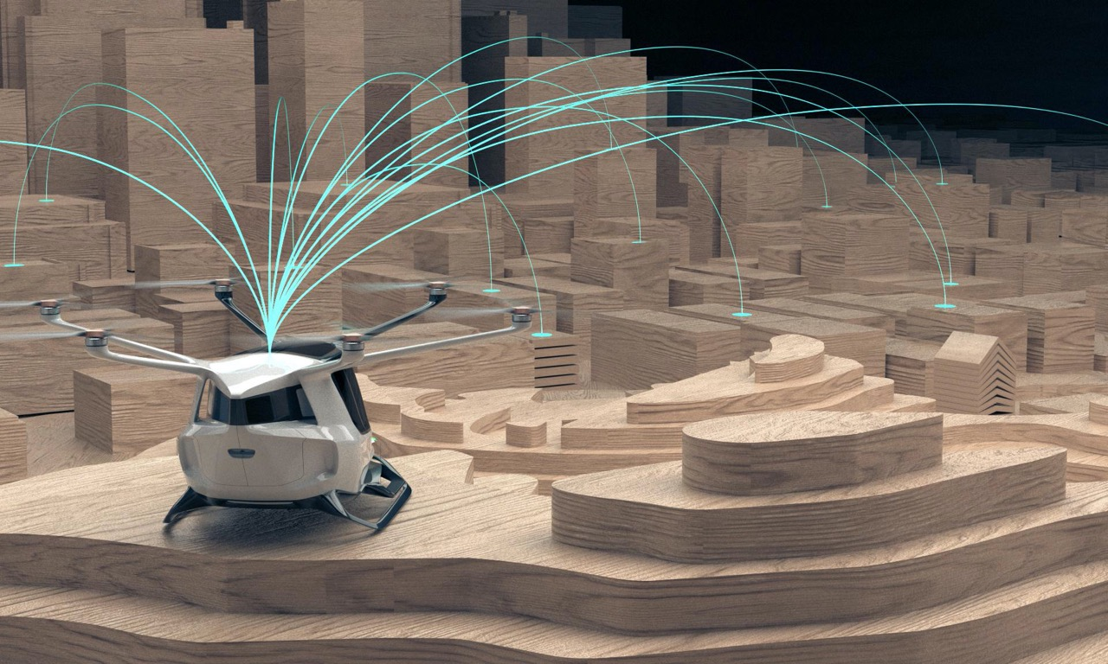




What is SKAI?
Skai is an advanced air mobility (AAM) system built with a relentless focus on simplicity- the first hydrogen fuel-cell powered electric vertical take off and landing vehicle.
Skai is comprised of multiple patent protected vertical take off and landing vehicles, air mobility services, and innovations in fuel source/propulsion systems. Its unique brand position and market entry strategy enable faster revenue generation and long-term sector leadership.
↓↑
All Electric Vertical Take Off and Landing
Hydrogen fuel cell powered, with zero pollution
Piloted, Ground-Piloted and Fully Autonomous Flight
Point-to-
Any-Point Transportation
Fueled by Hydrogen, Powered by Simplicity
Notes:
Skai is a radically simple air mobility system that is the first hydrogen powered eVTOL (electric vertical take off and landing) craft. For propulsion, Skai has developed an integrated suite of hydrogen supply, delivery and fueling solutions. Skai is an autonomous capable, multi-role advanced mobility system with two variants in development; The high payload Skai, and a mid-scale derivative, Skai Lift- an UAV with enhanced range and payload characteristics.
Safety is at the core of everything we do… keep it safe and simple.

Slide 4
Topics
A Technology View
Why Hydrogen?
Why Liquid Hydrogen?
Vehicle Design Implications
An Infrastructure View
How to achieve H2 at scale?
H2 at airports
H2 and Sustainability
Recycle – Reuse
Grey and Green Hydrogen
Notes:
I believe that we in the electric propulsion community are on the path to hydrogen solutions, we are simply at different points on the journey.
H2 is the only end-to-end sustainable option for powertrains that convert energy into aeronautical power.
Liquid

Slide 5


Hydrogen Powered Aerial Transport Solutions
Change the World
Everyday Air Mobility.
Fueled by Hydrogen.
Powered by Simplicity.
Thank You!

Slide 6
Energy Density of Fuel Cells Provides Endurance for Vehicle Design
Notes:
To better understand energy density, consider people lighting a fire while out camping. Evening has come, and it's time for S'mores, so it is time to build a fire. Naturally, the fire is first lit with kindling. It's high surface area-to-volume ratio means that it burns quickly—a high power density. Once the fire is going, kindling isn't a good fuel choice anymore, because it burns too fast. Now the fire burns better with logs because they have have a high energy density. A single log burns well for a long time.
To start with a different set of numbers, one kilogram of crude oil allows a car to drive ~20 km. Petroleum products, like gasoline are used because they are energy dense. A kilogram of nuclear fuel, like ²³⁵Uranium, would take a car 1.77 million km.
Despite the enormous efficiency advantage BEVs have over conventional vehicles (with much less of an advantage over FCEVs), lithium-ion batteries — the best batteries in volume production today— store 1/100th, or 1 percent, the energy density of gasoline.

Slide 7
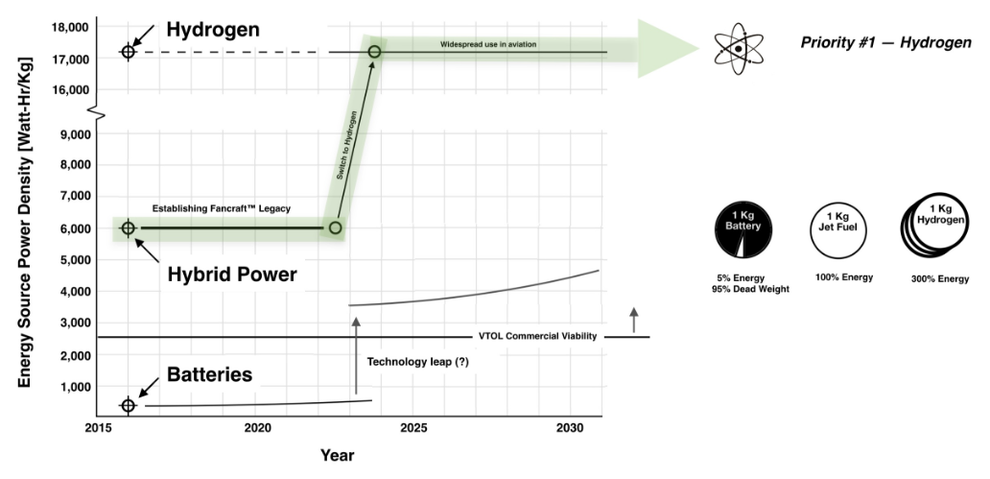
Overall competitive picture & LH2 advantage
Bottom Line: Batteries will ”never” catch up to LH2 HFC
Notes:
We may not be loosing momentum by not being first. Po

Slide 8
Weight Fraction Trends Among Different Aircraft Types
LH2 HFC eVTOL Mass Fractions
Various published sources of weights
Fixed Wing -- Large - >> Small
Light - >> Heavy RW
Battery eVTOLs
OEW fraction of Gross Weight increases with size and complexity -- More so for battery eVTOLs
Notes:
The Operating empty weight (OEW)is the sum of the empty weight and the crew plus their baggage.
eVTOLs WITH “NO FUEL” EXCEPT H2 HAVE SIGNIFICANTLY HIGHER OEW WHICH DRIVES PAYLOADS DOWN
REQUIRES MORE WEIGHT AND COMPLEXITY TO ACHIEVE SIMILAR VALUE PROPOSITIONS

Slide 9
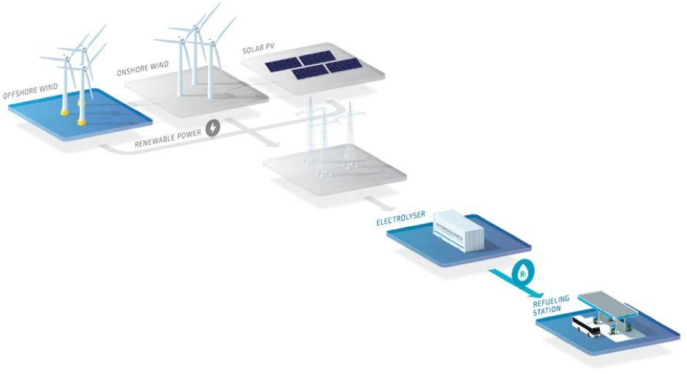

Green Hybrid Stations
- Onsite LH2 Generation
- LH2 for Skai
- GH2 for cars & trucks
- Electric vehicle charging
Green H2 Ecosystem
(H2 at Airports)

Slide 10
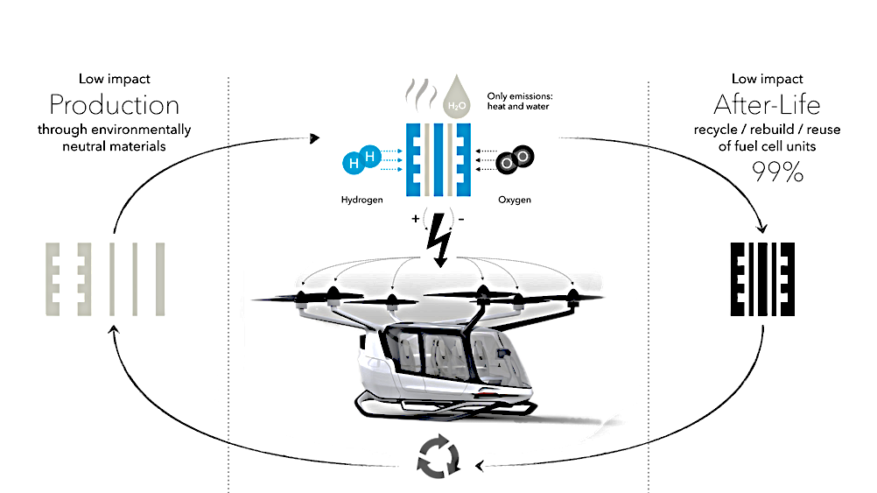
Hydrogen Lifecycle and Benefits
10k-15k
Flight hours Fuel Cell Life-cycle
Hydrogen provides 2-3X greater power density than lithium ion batteries.
Fueled by Hydrogen, Powered by Simplicity

Slide 11
Automation to Autonomy Roadmap
“Pilot Over The Loop”: Fully Autonomous with remote supervisory monitoring when FAA-NAS allows
NASA ULI S2A2 Project Support:
Access to Flight Test Data Acquisition
Simplified Vehicle Operational Capability (SVO)
Simulation Capability
A. Piloted (initial release)
B. Piloted with Automation:
1. Fully Manual ->
2. Stabilized -> en route/approach ->
3. Auto take-off/landing ->
4. Obstacle Avoidance
C. Autonomous

Slide 12
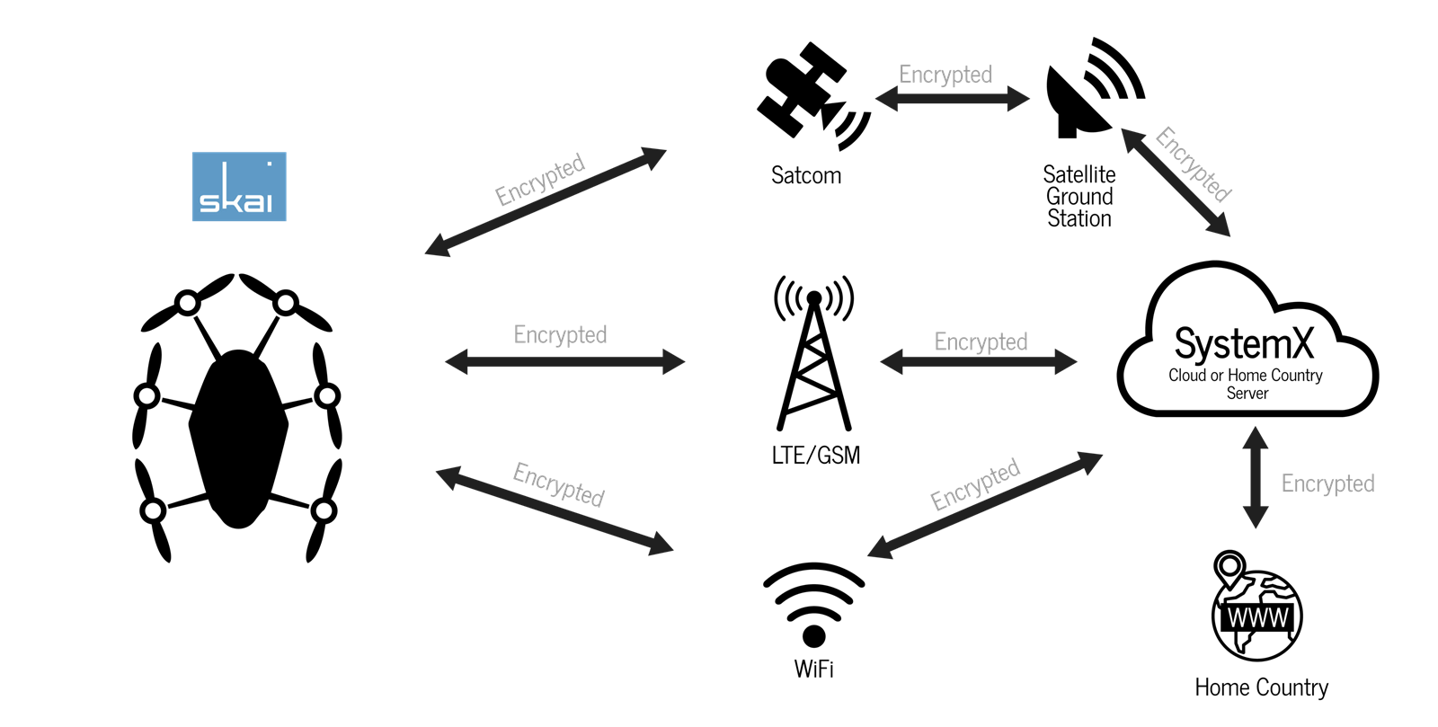
CCX System X for Secure Connectivity
Combined with a cyber-secure, certified Flight Control Computer solution, this kind of digital communications technology protects Skai against intended or unintended security intrusions.

Slide 13
Hydrogen Powertrain System Efficiency
All systems have losses between latent energy and power output.
Our losses come from:
Rotor Blades = 22-28% f (induced loss)
Fuel Cells = 50% loss (Heat)
Fuel Cell Support Equipment = 10% loss
Cooling Systems = 5% loss
Downwash from rotors on airframe = 7% loss
Aerodynamic Drag = f (viscous losses)
Geared Motors = 5-10% loss
And others …
Holmes Law of Abundances and Scarcities. “As a scarcity becomes an abundancy, consume that which is in abundance, to solve human needs.”

Slide 14
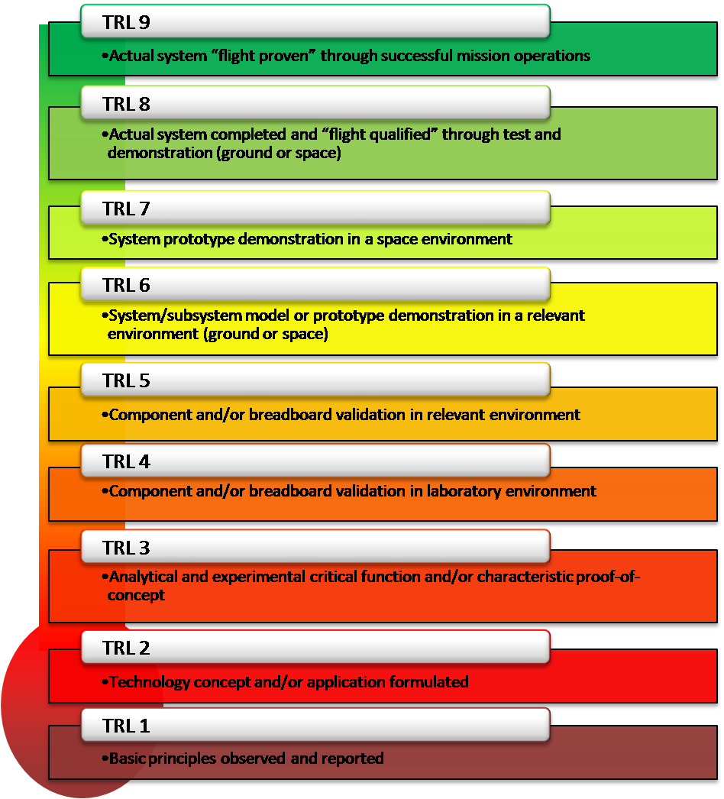
Hydrogen Propulsion Technology Readiness Levels (NASA)
Improving Technology Levels for Implementation
Electric Motors
Liquid H2 Tanks
Fuel Cells
Integrated Heat & Cooling
Aeronautical Hydrogen propulsion components are at R&D TRLs of 3-5 for larger manned versions at this time.
Notes:
TRL levels for larger hydrogen powered aircraft and vehicles are still in R&D( TRLs of 3-5 as shown) and NOT in technology implementation phase yet.
Only the Small drones for airborne applications and large hydrogen powered ground applications are at TRLs of 8 and 9

Slide 15
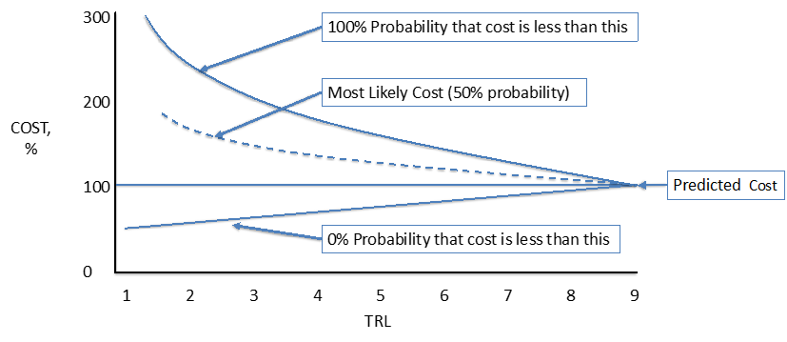
Predicting Development Costs with TRL

Slide 16
16

Slide 17
Hydrogen Coming Of Age
Ten nations have committed to advancement toward hydrogen economies over the coming years.
Primary drivers are environmental sustainability and Total Cost of Ownership (TCO).
Aeronautical H2 ecosystem includes OEMs and suppliers across the enterprise.

Slide 18
Hydrogen Powered Aerial Transport Solutions
Change the World
Everyday Air Mobility.
Fueled by Hydrogen.
Powered by Simplicity.
Thank You!

Slide 19
Hydrogen Technology Trajectories
The cost to produce hydrogen fuel cells has fallen 65% since 2010 and is projected to fall another 50% by 2025, as volume scales (https://blog.ballard.com/fuel-cell-price-drop), bringing the cost down from more than $1,000/kW a few years ago ($100,000 per car) to about $60/kW (about $6,000 per car) and with a DOE goal of $30/kW in coming years.
This year, Microsoft has pledged to become carbon negative by 2030, in part using HFCs to power Azure datacenter servers, in a cost-competitive replacement of diesel fuel powered generators, with H2 delivered by H2-powered long-haul vehicles, to ensure five-nines (99.999%) reliability. (https://news.microsoft.com/innovation-stories/hydrogen-datacenters/)
Hydrogen production costs are forecast to decline by 50% by 2030, making H2cost-competitive with some conventional fuels (https://hydrogencouncil.com/en/path-to-hydrogen-competitiveness-a-cost-perspective/)
Before the impact of any technological breakthroughs are considered, the Total Cost of Ownership of hydrogen vehicles is forecast to decline about 45%, at about 600,000 vehicles per year (https://hydrogencouncil.com/wp-content/uploads/2020/01/Path-to-Hydrogen-Competitiveness_Full-Study-1.pdf)
Notes:
Fuel cells are manufactured mostly from carbon, steel, and aluminum, where batteries rely on challenging commodities including cobalt, manganese, nickel, and of course, lithium.
HFC: Lowest TCO for zero-emission vehicles.
In terms of market demand for air mobility, how do hydrogen solutions create opportunities to meet that demand?
What technologies, beyond fuel cells, have matured or are maturing that support the use of hydrogen for electric air mobility?
On what timelines do you see hydrogen technologies and infrastructure reaching readiness for growth of the eVTOL and eCTOL industries?

